Slide 1
Climate Survey Debrief
Staff Toolkit

Slide 2
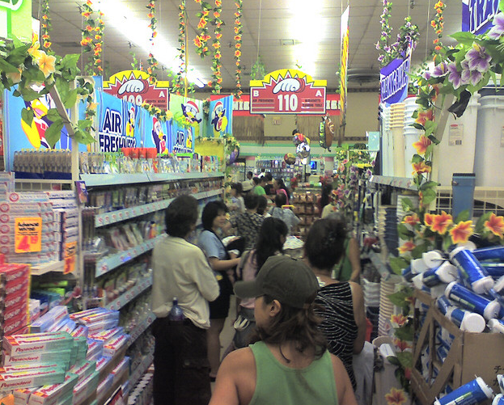
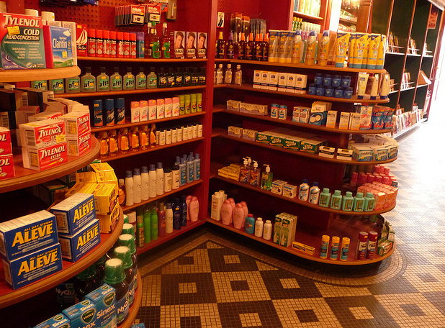
Envisioning School Climate
Notes:
Opening SEL activity:
“To begin, we’ll take a look at how a positive climate that is safe, respectful, participatory, engaging, and well–managed is established and what its impact is on students’ social and emotional development.
To create a here-and-now feeling of climate, think of a store you really don’t like to shop in. Describe it. How is the lighting, display, directions for finding merchandise, assistance, noise, smell? [Gather several responses.]
Now think of a store you love to shop in. What are its characteristics? “
Talking points:
Schools should have that same feel – orderly, safe, predictable, friendly, full of new things, great treatment by the staff, etc.
We as adults get to choose those environments to go to. Kids don’t have options, they are required to go to school. We should work to make that school as safe and positive a school environment as possible. No one wants to go to that uncomfortable store over and over – we wouldn’t engage, we’d shop quickly and get out of there, etc. The same thing happens to kids in a school – they don’t engage, they want out of there, etc. There are resources to help with building these school environments, but it starts with the staff at the school all treating each other and the students respectfully. For example, you can’t yell at a student to stop yelling.

Slide 3
Learning Intentions
1
2
Decompose the data to find trends
3
Discuss how we can support the students and school to enhance school climate
Build our understanding of the purpose and intention of the Climate Survey

Slide 4
WCSD Climate Surveys
All students in grades 5 – 9 and 11
  Climate Survey (N = 11,822)
  Safety Survey (N = 12,119)
  Online only
All parents in district
  Paper or online
  N = 12,091
All school staff in district
  Online
  N = 3,651
Did you know?
We have 5 years of data from the three surveys!
Notes:
The Student Climate Survey is something that more than 20,000 students in our school district participate in every year since 2011. That means that almost 1/3rd of all the students in the district give us their feedback through this survey.
In case you can’t remember taking it, this is the survey that you took in March – June last year. Probably in the computer lab. It asked questions about whether you like school or about your drug and alcohol use or how much you like your classes. We do this survey every year so we can figure out what we are doing well

Slide 5
Some Patterns to Examine
Trends over time
Comparison to District OR a “like” school
Vertical Alignment: ES vs. MS vs. HS
Student vs. Parent vs. Staff Surveys
Don’t forget to ask for your school’s parent and staff comments! Email ldavidson@washoeschools.net
Notes:
There are many different ways to look at school climate data. In addition to what you see in this year’s report, consider looking at other trends in the data:
How have your scale scores changed from this year to previous years’? We encourage you to examine scale scores (total percentage agreement captions on the first page like “80% of staff agree that they have high expectations for all students”) rather than individual items over time, since those tend to be more reliable. Why do you think the scores have changed year over year? What other events or changes occurred during that year that contribute to the percentage difference?
Although we compare your school’s scores with the same school-level in the report, you might want to look at how your school compares to a “like” school. If you are a school that receives Title I funding, you may want to pull up reports for other Title I schools to compare. Or, if your school is implementing Social and Emotional Learning for the first time this year, you may want to look at another school that is also in their first year of implementation.
How do staff’ opinions change from elementary to middle to high school in your vertical? Do most staff feel more engaged in elementary schools vs. high schools? If so, why might that difference exist?
There are similar and/or identical items on the staff, student, and parent surveys. How do your staff’s beliefs about student drug use compare to students’ actual self-report of their own drug use? Are the reports similar or different?
All staff and parents were asked several open-ended questions about their school. However, because specific names and identifying information were included in some comments, they have to be de-identified before we can give them to you. There are hundreds of comments though, so please remember to request them from ldavidson@washoeschools.net so you can use this great information for action-planning at your school!

Slide 6

STAFF RESPECT AND COLLABORATION
INSTRUCTION AND PARENT INVOLVEMENT
STAFF-STUDENT RELATIONS
SAFETY
Fairness and Respect
Staff Collaboration
Early Release Wednesdays
Instructional Focus
Parent Involvement
Social-Emotional Learning
Staff Climate Survey
School Safety
Student Behavior
Staff-Student Relationships
Expectations of Success
Notes:
These are the types of things we ask staff about on the Staff Climate Survey. You’ll notice many of the topics are similar between the staff, student, and parent surveys.

Slide 7
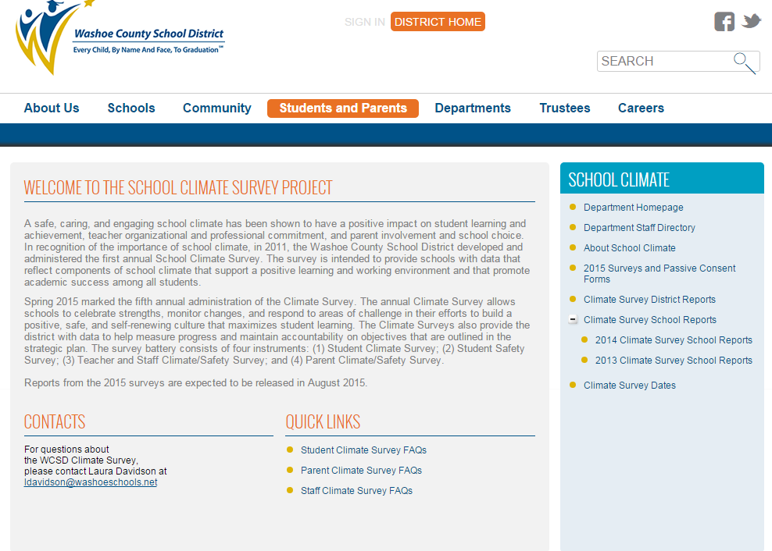
http://www.washoeschools.net/Page/866
Notes:
Here is where YOU can find your school’s survey reports. The link is at the top.

Slide 8
Notes:
[You can replace these with your own school’s data. But, it’s nice to show snapshots from your data or print out the reports so everyone can see the same data. Ideally, you want to look at the graphs on the front page of the report, and then dig into the scale more deeply by looking at the corresponding table. The scale is more reliable because the number is based on all the questions, but it’s also nice to look at the actual questions in the scale and what is high or low. Using the snapshot tool in Adobe Acrobat, you can take pictures just like this from the reports that you can then copy and paste into this sample powerpoint]

Slide 9
Here’s What, So What, Now What
What does the data tell us?
What does it not tell us?
What is the good news?
How will we celebrate?
Notes:
10 min.
Participants review data independently first, then draw their attention to specific areas or trends you would like them to focus on.
Ask them to respond to the questions on the slide verbally in their group and record their thoughts on the handout.

Slide 10
So What?
Why is this data important?
What feedback can you offer about certain trends?
How does this impact you as a staff member
Notes:
10 min.
Ask participants to respond to the questions on the slide verbally in their group and record their thoughts on the handout.

Slide 11
Now What?
Looking at the school goals and data, what action steps can we take as a school community?
  How will we get to where we want to be?
  How will we improve practice with what we have learned?
Notes:
10 min.
Ask participants to respond to the questions on the slide verbally in their group and record their thoughts on the handout.
Remind them that the purpose of the discussion is to review the data as a community in order to work together to improve the school climate. Keep everything light and positive!

Slide 12
3, 2, 1 Activity
3 things you found interesting about the data
2 things you want to know more about after looking at the data
1 thing you want to do right now as a result of the data
Notes:
These questions can either be used as a closing activity discussed verbally with a partner or as a reflection sheet to be turned in to the Climate survey team and site administrator.

